Slide 2
PLACE fieldwork
Level 1: Community informant interviews
Level 2: Venue informant interviews and mapping
Level 3: Patron and worker interviews and HIV testing
Notes:
We have already gone over the second level of PLACE fieldwork, venue informant interviews, and mapping. Now, we will talk about Level 3: returning to some of the venues to interview patrons and workers and so that they can be tested for HIV.

Slide 3

Purpose of interviews and tests
Collect information about characteristics of people who visit venues (patrons and workers), sexual behavior, and exposure to HIV prevention programs
Collect information about HIV status
Notes:
Note: Adapt slide if there is no HIV testing, or if there are other tests in addition to HIV being conducted, such as syphilis, gonorrhea, etc.
The primary purpose of these interviews is to find out about the people who visit the venue or who work there, such as:
Characteristics – age, education, how often they visit the venue, other venues they visit
Sexual behavior – number of sex partners, condom use, any behavior characteristic of key populations such as using injecting drugs, having sex for money, or men having sex with men
HIV prevention exposure – any contact with peer educator, received condoms for free, purchased condoms, last HIV test
Each person interviewed will also be tested for HIV and we will link their test results with their interview results. Professional testers and counselors will perform that part of the protocol and we will work in cooperation with them.

Slide 4
How do we get this information?
Visit some of the venues.
Interview all people working there.
Interview people visiting there (referred to as patrons).
The testing and counseling team will conduct rapid HIV tests and provide counseling pre- and post-test.
Notes:
Note: Adapt slide if there is no HIV testing, or if other tests in addition to HIV are being conducted, such as for syphilis, gonorrhea, etc.
We are not able to visit every venue we already visited for Form B. So, we will take a sample of venues. You will only visit the venues selected for the sample at a busy time. Most venues will be visited at night.
We will ask all people working at the venue at the time of our visit to participate.
You will recruit patrons randomly from these venues because we want the results to represent all people there. This means you will be trained on how to pick whom you will ask to participate. Remember that we use the word “patron” to refer to people visiting a place or socializing there.
We will collaborate with a team of HIV testers and counselors. They will set up their equipment to take a drop of blood from each participant’s finger and test it for HIV. They will give the participant the results during our visit.

Slide 5

Working in teams
Venues always visited by a team of interviewers
Interview simultaneously
Joined by HIV counseling and testing team
Notes:
For community informant interviews and venue visits, interviewers work in pairs. For these interviews with Form C, a team will visit the venue at the same time. We want to interview many people while there, and each interviewer can be working simultaneously. In this way it is possible to visit one or two venues per night.
Because each respondent will be tested for HIV and given pre-test and post-test counseling, we will be joined by trained and experienced counselors and testers who will conduct that portion of the fieldwork. The national testing and counseling guidelines will be followed and anyone testing positive will be linked to care, just as they would if testing at a clinic.
Note: Can mention the number of people to be interviewed at each venue. Can also mention the size of the teams (i.e., number of interviewers visiting a venue together for individual interviews).

Slide 6
Who is interviewed at venues?
Men and women visiting the venue for 20 minutes or more on the night of fieldwork
Men and women working there the night of fieldwork, including women living at the venue
Must be 18 years old or older; or must be 15 to 17 years old and at the venue independent of their family
Notes:
Note: Adapt minimum age if necessary.
We want to interview men and women who visit the venue but are not just there briefly—in other words, people who spend time there socializing for 20 minutes or more. At most venues, people will spend quite a bit of time, but if a place such as a shop is considered a venue for PLACE, some people may be there for only a few minutes to run an errand and therefore should not be included.
We will ask all men and women working on the night we are there to participate. Some women who work at venues also live there. This is an important group for HIV prevention and treatment.
Anyone 18 years old or older can participate. People 15, 16, or 17 years old may also participate, but only if they are not visiting the venue with their parents or other family members and if they are acting independently. Someone running an errand for a parent, for example, or out for a meal with their family would not be acting independently and therefore would not be eligible. But many times, people of 15 to 17 years visit venues on their own accord. They are eligible.
We will cover eligibility in more detail later.

Slide 7
Supervisor gives instructions
For Forms A and B, interviewers identified informants
Different for Form C:
  interviewers are trained how to select a participant
  Supervisor communicates frequently with interviewers about selecting people to recruit
Notes:
For Forms A and B, interviewers decided who would be a good informant. Interviews asked about venues and not about the informant’s own life.
Form C is different, in that it asks about a person’s own behavior and experiences. How a participant is identified is important. With several interviewers working at a venue at the same time, the Fieldwork Supervisor will coordinate who each interviewer recruits next. There will be a lot of communication between the supervisor and interviewers throughout a visit to a venue. Before and after each respondent has completed the process of HIV testing and the interview, the supervisor will check in with each interviewer.

Slide 8

What about key populations?
Target number of men and women
Some will be members of key populations (sex workers, men who have sex with men, people who inject drugs, etc.)
Supervisor will tell you if there is another strategy for identifying key populations to interview
Notes:
Note: Adapt slide if there are other plans for finding key populations to interview, such as oversampling.

Slide 9
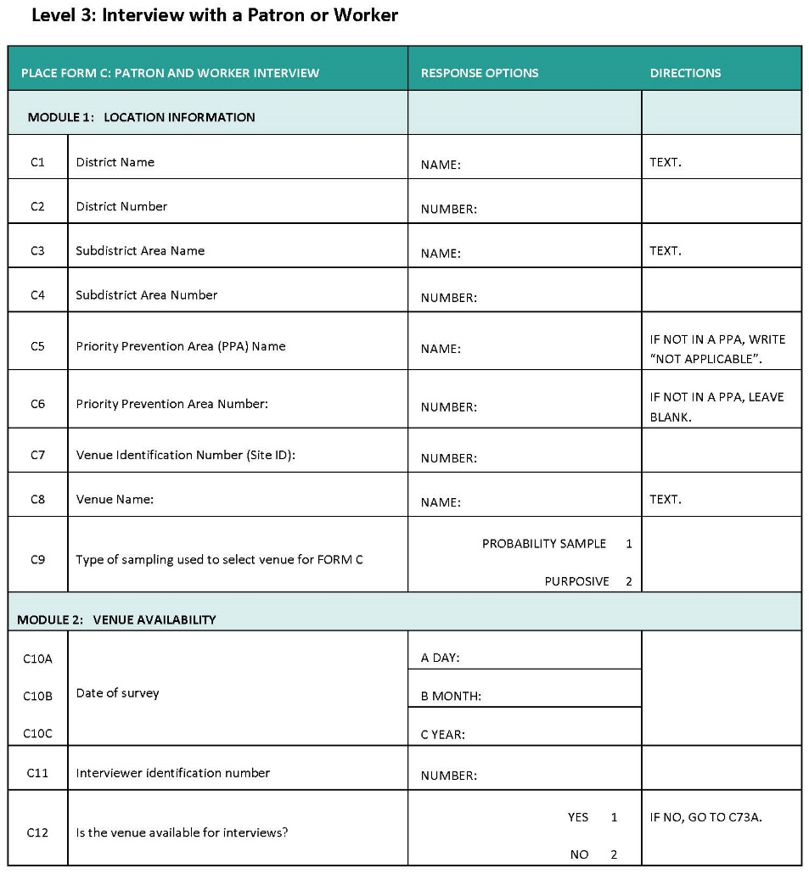
Questionnaire
Form C: Patron and Worker Interview
Includes a code that will be used to link interview to HIV test results

Slide 10
Steps 1-6:
Fill in venue information
Get assignment from Fieldwork Supervisor
Identify someone to recruit
Introduce yourself and describe interview
Offer Form C Informed consent fact sheet. Respondent initials it to indicate consent.
Confirm eligibility (willing, age 18 or older, or age 15-17 if there independently)
(continued)
Notes:
Note: Adapt to reflect agreed-upon steps. If not using incentives, delete step 10.
READ SLIDE
We will go over all of this in more detail and you will be given a copy of these instructions to carry with you.

Slide 11
Steps 7-11:
Bring participant to HIV testing and counseling team
Conduct interview in private location
Return with participant to receive results and counseling
Ensure participant receives incentive
Report to s Fieldwork Supervisor to record completed interview and to receive next assignment
Notes:
Note: Adapt to reflect agreed-upon steps. If not using incentives, delete step 10.
READ SLIDE
We will go over all of this in more detail and you will be given a copy of these instructions to carry with you.

Slide 12
Fact Sheet
Fact Sheet
Notes:
Note: Give one copy of Form C, one copy of the Form C informed consent fact sheet, and one copy of interviewer Instructions to each interviewer. Even if this study will use tablets or phones to record interview responses, distribute a paper copy of the form at this time. Training on tablets will occur only after the content of Form C is reviewed.

Slide 13
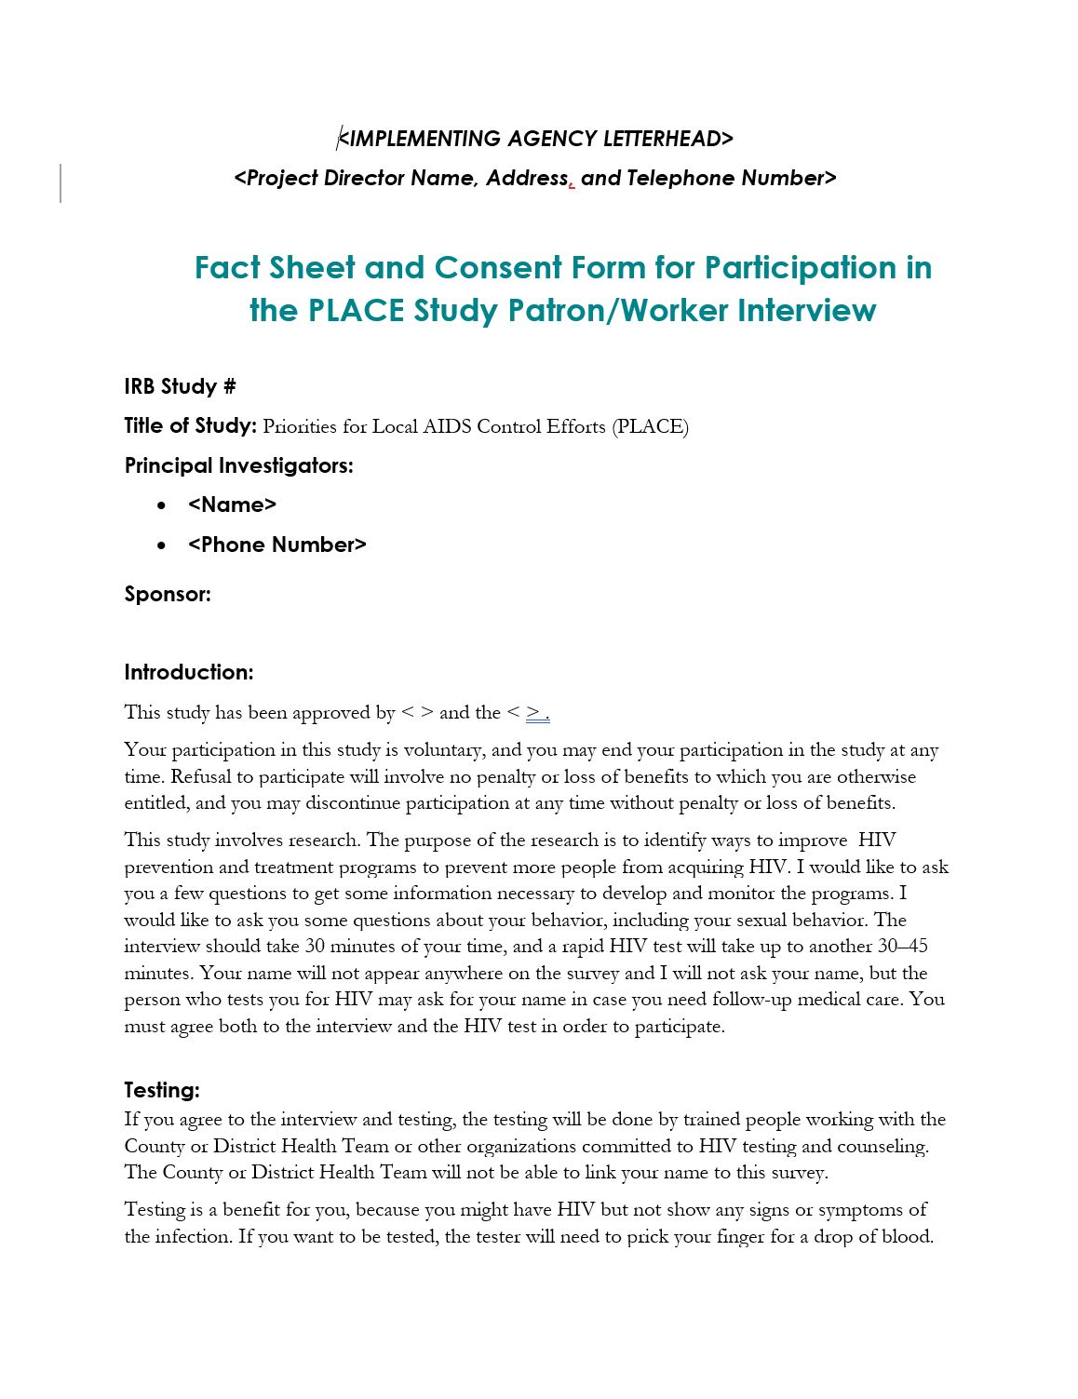
Fact sheet
(front)
Notes:
Note: Insert screenshot of fact sheet including initials of a respondent at the top to illustrate how informed consent will be recorded for Form C and testing.
Now we will review the fact sheet.
As in the other interviews, we also give a fact sheet to people at venues.
Again, much of this is the same as for Forms A and B; the section on what the survey covers is different.
The testing and counseling team will administer their own informed consent. For that reason, the information on testing is not detailed here.

Slide 14
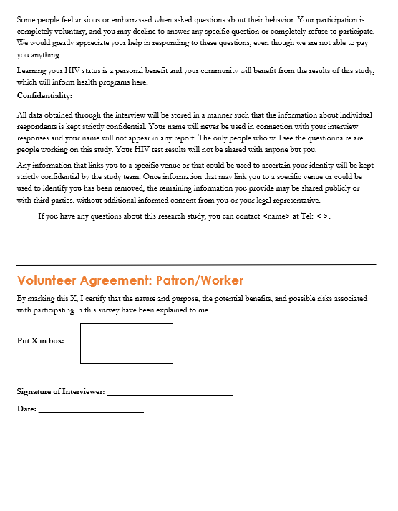
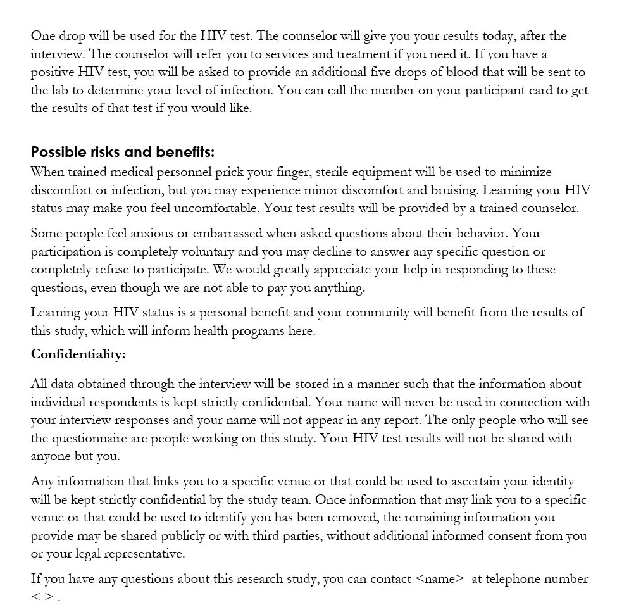
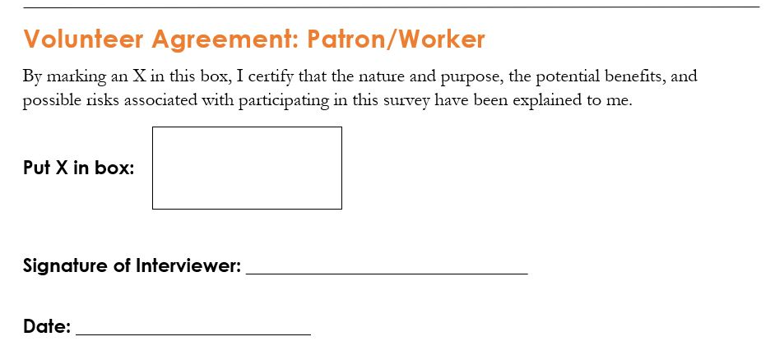
Fact sheet
(back)
Notes:
Note: Insert screenshot of fact sheet including initials of a respondent at the top to illustrate how informed consent will be recorded for Form C and testing.
Because Form C asks about personal behavior and testing requires a finger prick, it is important to have a record that informed consent was given. For each respondent, two copies of the fact sheet are needed. The participant writes his or her initials or the letter X at the top of one copy to indicate consent. The PLACE team keeps that copy. The other copy is offered to the participant. We do not want participants to write or sign their name, because that would make it possible to identify participants. Participant identity should remain anonymous to the PLACE team.

Slide 15

Activity: Read fact sheet
Read the changed sections of the fact sheet aloud.
Interviewers take turns reading the section “What will the survey cover?” and the section on testing.
Feel free to ask questions about the content of the fact sheet.
Notes:
Note: The purpose of this activity is for interviewers to hear sections of the fact sheet revised for Form C read aloud while they read along.
Note: The trainer responds to any doubts the interviews have regarding interpretation.
This fact sheet is mostly the same as the one used in Forms A and B. Two sections are different. Let’s read aloud the section “What will the survey cover?” and the section on testing.
Again, the participant must write his or her initials or the letter X at the top of one copy of the fact sheet. The PLACE team keeps this copy. Another copy of the fact sheet is offered to the participant to keep.

Slide 16
Form C:
Individual Interview

Slide 17
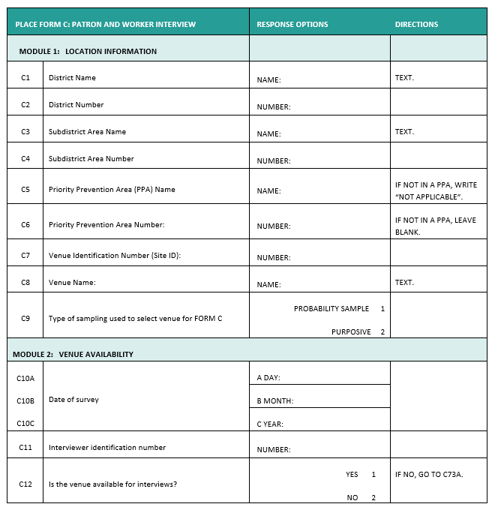
Form C: Interview with a patron or worker
Notes:
NOTE: Insert image of Form C here as adapted for this specific PLACE study.

Slide 18
Form C content
Information about venue of interview
Demographics
Venue attendance
Drug use
Sexual behavior
Other venues visited
Key populations
Symptoms and use of services
Vulnerabilities
Self-completed section
Notes:
Note: Adapt this slide to reflect the sections of Form C that will be used for this application of PLACE.
This list gives you an idea of the different sections of Form C. You will become familiar with specific content as we review these sections.

Slide 19
Activity: Read questions
Read Form C aloud.
Interviewers take turns reading a question and its answer categories.
Later, the questions will be explained in depth.
Notes:
Note: The purpose of this activity is for interviewers to hear the questions read aloud while they read along. Taking turns reading a question keeps interviewers engaged. Interviewers must read through all of Form C to become familiar with the content.
Note: Unlike in the Form A training, the trainer will not explain each question at this time. This is because of the length of Form C. Later, when reviewing one section of the form at a time, each question will be discussed further.

Slide 20
Form C content
Information about venue location and availability
Recruitment
Demographics
Venue attendance
Drug use
Sexual behavior
Other venues visited
Key populations
Symptoms and use of services
Vulnerabilities
Self-completed section
1
2
3
Notes:
Note: Adapt this slide to reflect the content areas of the version of Form C that will be used for this application of PLACE and the best way to divide it into sections for training purposes.
For training purposes, we divided Form C into three sections. We will go into detail about the purpose and intent of each question, and then will practice interviewing that section in pairs before moving on to the next section.

Slide 21
Activity: Read questions in Section 1
Read Section 1 of Form C aloud again.
Interviewers take turns reading a question and its answer categories to the group.
After each question is read, the trainer describes the type of information sought and answers any questions.
Notes:
Note: The purpose of this activity is for interviewers to learn the intent of each question and discuss the answer categories.
Now we will go back to the beginning of Form C and focus on the questions in the first section of the survey. The purpose and intent of some questions will be obvious, but others will require explanation. This is a time to ask for clarification about survey questions.

Slide 22
Section 1: Information about venue of interview
Basic information: Venue name, ID, etc.

Slide 23
Section 1: Recruitment —type of respondent
We will cover recruitment in more detail later.
Overview:
  Some patrons will be chosen randomly.
  It’s important not to select only friendly people or people from the same group of friends.
  Others may be chosen purposively.
  This means some will be chosen because of certain risk factors (for example: female sex workers, women who live at the venue, transgender women).
Notes:
Note: This slide is intended to be reviewed in conjunction with the relevant survey question/s. Only slides for questions that may need more explanation are included here.
Note: if no purposive sampling will be done, remove the last two bullet points. Make any other adaptations based on sampling strategy identified.
One question in the survey asks: What type of respondent are you recruiting?
The Fieldwork Supervisor will tell you what type to recruit before each respondent you look for. After you complete one interview, you will speak with the supervisor, who will tell you the next type of respondent you will look for.
Most venue patrons will be recruited randomly. That is, we do not want interviewers to decide whom to interview on their own. Some interviewers might choose to interview only friendly-looking people, only people of a certain ethnic group, or only people who came to the venue as a group. If this happened, our results would not be a good representation of people at the venue. For this reason, we need to select them randomly. We will explain how to do this later.
Other people may be selected intentionally, or purposively. For example, some female sex workers may be interviewed among those women selected randomly. But to be sure we interview enough of them to understand their behavior and exposure to HIV prevention programs, we may need to look for them intentionally. This will only be done if the Fieldwork Supervisor tells you to do so.
The question on the survey is important, because this is where you describe the recruitment instructions that the Fieldwork Supervisor has given you.

Slide 24
Section 1: Recruitment of 15- to 17- year-olds
Usually people <18 are not considered adults who can make decisions
People 15, 16, and 17 visit venues and are vulnerable; do not miss chance to interview!
If at venue independently (like an adult), we can interview
If at venue with parents or running a family errand, we CANNOT interview!
Notes:
Note: This slide is intended to be reviewed in conjunction with the relevant survey question/s. Only slides for questions that may need more explanation are included here.
Note (VERY IMPORTANT): if people under 18 will not be interviewed at all, delete this slide.
People 18 and older are considered adults and able to decide for themselves whether they want to participate.
However, people ages 15, 16, or 17 are not considered adults. For some studies, people of this age must have their parents’ permission to participate. This would not be possible. We do not want to miss the opportunity to interview people in this age group, because they can be more vulnerable to HIV and other health issues. People in this age group visiting venues to look for a sex partner are acting as independent adults, and therefore we have permission to interview them. We ask questions to establish whether they are at the venue with a parent or visiting on a family errand. In those cases, they are not acting independently so we would not interview them. We only interview people 15 to 17 who are acting independently.
This question is very important!!! We must only recruit people in an ethical manner, by asking this question of 15- to 17-year-olds!

Slide 25
Section 1: Recruitment
If not willing to take HIV test, cannot participate: END INTERVIEW
Is respondent capable of answering questions?
  Drunk
  Does not understand
Notes:
Note: This slide is intended to be reviewed in conjunction with the relevant survey question/s. Only slides for questions that may need more explanation are included here.

Slide 26
Section 1: Demographics
Residence – how long?
Education
Employment
Notes:
Note: This slide is intended to be reviewed in conjunction with the relevant survey question/s. Only slides for questions that may need more explanation are included here.

Slide 27
Section 1: Venue attendance on Saturday night
We visit venues on different days of the week.
Ask about Saturday night in some questions so that everyone is talking about the same day of the week.
Last Saturday =
  If interviews occur Sunday, it is the day before.
  If interviews occur Monday through Friday, it is the previous Saturday.
  If interviews occur on a Saturday, it is the Saturday of the prior week, NOT that same day.
Notes:
Note: This slide is intended to be reviewed in conjunction with the relevant survey question/s. Only slides for questions that may need more explanation are included here.

Slide 28
Section 1: Drug use
Alcohol use can lead to poor judgement and increased risk behavior.
It’s important to ask about sharing needles, because this is one way that HIV is transmitted.

Slide 29
Activity: Practice Section 1
Interviewers form pairs.
One interviewer takes the role of venue patron or worker while the interviewer conducts Section 1 of the Form C interview.
Reverse roles to give the other interviewer practice.
Make up responses! It is not necessary to reveal personal information!
Questions about this section of the Form C interview?
Notes:
Note: Make sure interviewers have several blank Form Cs to complete during practice. If there is time, interviewers can change partners and practice again.
Note: The purpose of this activity is to give the interviewers a chance to read each question aloud and to fill in Form C with the responses.
Now you will form pairs and practice only that section of Form C with one of you taking the role of general venue informant and the other that of the interviewer. Afterward, reverse roles so that your partner can practice.
We do not want you to answer honestly during practice. You can pretend to be anyone you want and make up answers as you go along. This is true for all practice in pairs.
(Once everyone is finished) How did the practice go? Does anyone have any questions?

Slide 30
Activity: Read questions in Section 2
Read Section 2 of Form C aloud again.
Interviewers take turns reading a question and its answer categories to the group.
After each question is read, the trainer describes the type of information sought and answers any questions.
Notes:
Note: The purpose of this activity is for interviewers to learn the intent of each question and discuss the answer categories.
Now we will move on to the second section of Form C and repeat the process. First, let’s take turns reading the questions aloud and discussing them as a group.

Slide 31
Section 2: Sexual behavior— sex with men
# of men had sex with in past 12 months
More questions about sex with men follow: condom use, anal sex, etc.
Some use 3-month time frame
Read each question exactly as written!!!!
Notes:
Note: This slide is intended to be reviewed in conjunction with the relevant survey question/s. Only slides for questions that may need more explanation are included here.
We ask it the same way to every respondent, whether a man or a woman. This allows for men who have sex with men to respond without asking their sexual orientation or identity.
Some questions ask about behavior in the past 3 months instead of the past 12 months. There are subtle differences among questions, so it is important to read each question exactly as it is written! Never assume you can memorize the wording of a question.

Slide 32
Section 2: Sexual behavior— paid sex
Paid a woman for sex in past 3 months
Paid a man for sex in past 3 months
Received money for sex in past 3 months
Notes:
Note: This slide is intended to be reviewed in conjunction with the relevant survey question/s. Only slides for questions that may need more explanation are included here.
We ask it the same way to every respondent, whether a man or a woman. Although men paying women for sex is the most common type of transactional sex, we want to allow for any type of paid sex to be reported.
We ask about paying a man or woman for sex, and also if they were paid money for sex.

Slide 33
Section 2: Sexual behavior— new partners
Have you had sex with a person in the past 12 months with whom you never had sex before?
  First time with this person
  Does not matter whether the respondent had sex only once or many times
In the past 3 months, have you met a new sex partner here at this venue?
Notes:
Note: This slide is intended to be reviewed in conjunction with the relevant survey question/s. Only slides for questions that may need more explanation are included here.
Note: Edit slide to reflect exact wording in adapted questionnaire.
We want to know if the person has had sex with a new partner. A new partner is someone with whom the respondent had sex for the first time. A new partner could be someone with whom the respondent had sex only once and never again or many times.
We then want to know about meeting a partner recently at the venue where the interview takes place.

Slide 34
Section 2: Other venues
Ask the respondent about other venues they have visited in the past 7 days.
Ask whether the respondent has used a social media app to meet a sex partner.
Notes:
Note: This slide is intended to be reviewed in conjunction with the relevant survey question/s. Only slides for questions that may need more explanation are included here.

Slide 35
Section 2: Sexual behavior
# of men respondent had sex with in past 4 weeks
Of those, how many were new partners?
  **Should be less than total # in past 4 weeks**
# of women respondent had sex with in past 4 weeks
Of those, how many were new partners?
  **Should be less than total # in past 4 weeks**
Ask again about # of men/women/transgender women respondent had sex with in past 12 months
Notes:
Note: This slide is intended to be reviewed in conjunction with the relevant survey question/s. Only slides for questions that may need more explanation are included here.
Next is a series of questions asking about numbers of sexual partners in past 4 weeks. We want to know the total number of partners, and then of those, how many were new. The first number we ask for is the total number. Then, we ask, of those, how many were new. This second number should be less than the first number the respondent gave. If it is not, clarify with the respondent which number is correct.
We ask about men and women partners.
We then ask for a specific number of men the respondent had sex with in the past 12 months. Previously, the response options were given in ranges, but this asks for a specific number. The same is done for women. The question clarifies that the respondent should not include transgender women in the counts of men or women.
Then we ask about the number of transgender women the respondent had sex with in the past 12 months.

Slide 36
Section 2: Key populations
Series of questions about # of people respondent knows who visit venues
  Talked to in past 4 weeks
  You know them and they know you
Men who have sex with men
Female sex workers
  Also ask about Saturday nights
Notes:
Note: This slide is intended to be reviewed in conjunction with the relevant survey question/s. Only slides for questions that may need more explanation are included here.
Note: This slide must be edited to reflect key populations of interest--those that appear in the adapted questionnaire. These questions are used for estimating the size of key populations.
Next is a series of questions that ask about the number of different groups of people the respondent knows, and of those, how many go out to bars and clubs.
How do we define whether the respondent “knows” someone? We specify they talked to the person in the past 4 weeks. If the respondent is thinking of people they know just a little but are friends of friends, they aren’t likely to know whether they go to bars or clubs.
We also specify in the questions that “you know them and they know you.” This is another way to get respondents to think about people they know well enough to know their venue-visiting behavior.
The survey has questions about people in general, and also about key populations.

Slide 37
Activity: Practice Section 2
Interviewers form pairs.
One interviewer takes the role of venue patron or worker while the interviewer conducts Section 2 of the Form C interview.
Reverse roles to give the other interviewer practice.
Questions about this section of the Form C interview?
Notes:
Note: Make sure interviewers have several blank Form Cs to complete during practice. If there is time, interviewers can change partners and practice again.
Note: The purpose of this activity is to give the interviewers a chance to read each question aloud and to fill in Form C with the responses.
Now you will form pairs and practice only that section of Form C with one of you taking the role of general venue informant and the other that of the interviewer. Afterward, reverse roles so that your partner can practice.
(Once everyone is finished) How did the practice go? Does anyone have any questions?

Slide 38
Activity: Read questions in Section 3
Read Section 3 of Form C aloud again.
Interviewers take turns reading a question and its answer categories.
After each question is read, the trainer describes the type of information sought and answers any questions.
Notes:
Note: The purpose of this activity is for interviewers to learn the intent of each question and discuss the answer categories.
Now we will move on to the third section of Form C and repeat the process. First, let’s take turns reading the questions aloud and discussing them.
Instructions for measuring mapping coordinates will come later.

Slide 39
Section 3: Symptoms and services
Sexually transmitted infections
Tuberculosis (TB)
Circumcision
Be careful of time references (4 weeks, 12 months, 2 weeks)
Notes:
Note: This slide is intended to be reviewed in conjunction with the relevant survey question/s. Only slides for questions that may need more explanation are included in these slides.
Note: The series of questions about symptoms includes one for men about whether they are circumcised. In some places, people are not familiar with the word and will need more information to answer the question. If that is the case, include a separate slide to educate the interviewers about circumcision and provide words to describe it to respondents.
The questionnaire asks about symptoms of sexually transmitted infections and tuberculosis.
One question asks: Are you a circumcised man? Do not skip answering this question if the respondent is a woman. Instead, mark code 9 for “not applicable: female.”
Again, it is important to read the questions as written. This series of questions asks about different time frames. Sometimes the questions ask about experiences in the past 4 weeks, 12 months, or 2 weeks. Make sure to emphasize this to the participant.

Slide 40
Section 3: Symptoms and services
Health services for drug users?
Sources of information on HIV/AIDS?
Free condoms?
Peer education?
Purchased condoms?
Carry condom? – MUST SEE IT TO MARK YES
Lubricant?
HIV testing?
HIV-positive and on medication?
Notes:
Note: This slide is intended to be reviewed in conjunction with the relevant survey question/s. Only slides for questions that may need more explanation are included here.
There are many questions to learn about whether programs have reached people at venues.
We use this information to find out about gaps in services so that they can be addressed by improving programs.

Slide 41
Section 3: Vulnerabilities
Vulnerabilities are factors that can affect a person’s risk for acquiring HIV
Includes question about sexual orientation and gender identity
Notes:
Note: This slide is intended to be reviewed in conjunction with the relevant survey question/s. Only slides for questions that may need more explanation are included here.
Certain challenges in a person’s life can increase their risk for acquiring HIV. We ask about many issues that can affect a person.

Slide 42
Gender identity questions:
Who are transgender people?
Transgender people identify with a different gender than the one they were assigned at birth.
For example, a transgender female was born male but over time felt more like a female than a male. In some cases, transgender people get hormone injections to change their appearance. “Trans” means “changed.”
A transgender male was born female and became male.
Transgender women are especially at risk of acquiring HIV.
Notes:
Note: This slide is intended to be reviewed in conjunction with the relevant survey question/s. Only slides for questions that may need more explanation are included here.
Note: This slide was seen in the PLACE overview the first day of interviewer training and also in venue informant training. It is included here to make sure interviewers understand the definition of transgender people and how it relates to two questions in Form C.
The last two questions in the section are about gender identity: Do you see yourself as a man or a woman? And were you born male or female?
Using the responses from these questions, we can determine which respondents are transgender. Not all transgender people may identify as transgender, so we ask these two straightforward questions.

Slide 43

Section 3: Self-completed
Few questions
Respondent marks answer
Pictures useful for people who cannot read: mark tree for yes, soccer ball for no, sun for man, and moon for woman
Interviewer reads questions and prompts respondent to mark answer (holds tablet out, directly facing the respondent, facing away from interviewer)
Notes:
Note: This slide is intended to be reviewed in conjunction with the relevant survey question/s. Only slides for questions that may need more explanation are included here.
The final section of the interview asks the respondent to mark the response to the questions you read. These are sensitive questions about sexual behavior, HIV status, sexual orientation, and gender identity.
You should make it clear that you cannot see the response. By doing this, the respondent has no reason to misrepresent the truth about their life. They will have complete privacy.

Slide 44
Section 3: Interviewer
After the interview, there are a few questions about the interview.
Space is given to enter the result of the HIV test. LEAVE THIS BLANK. It will be filled in by the Fieldwork Supervisor later.
Notes:
Note: This slide is intended to be reviewed in conjunction with the relevant survey question/s. Only slides for questions that may need more explanation are included here.

Slide 45
Activity: Practice Section 3
Interviewers form pairs.
One interviewer takes the role of venue patron or worker while the interviewer conducts Section 3 of the Form C interview.
Reverse roles to give the other interviewer practice.
Questions about this section of the Form C interview?
Notes:
Note: Make sure interviewers have several blank Form Cs to complete during practice. If there is time, interviewers can change partners and practice again.
Note: The purpose of this activity is to give the interviewers a chance to read each question aloud and to fill in Form C with the responses.
Now you will form pairs and practice only Section 3 of Form C, with one of you taking the role of general venue informant and the other the interviewer. Afterward, reverse roles so that your partner can practice.
(Once everyone is finished) How did the practice go? Does anyone have any questions?

Slide 46
Putting It All Together
Notes:
Now that we have reviewed the Form C informed consent fact sheet and Form C, let’s put them together as one set of steps.

Slide 47
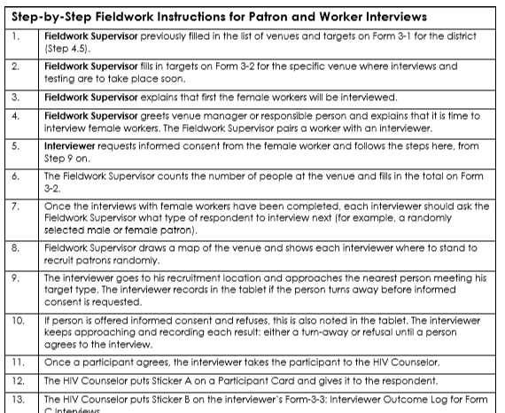
Steps
Notes:
Note: Replace the image of Interviewer Instructions with the version that will be used in this application of PLACE.
We will now review the steps for recruiting individuals at venues with the Form C informed consent fact sheet, conducting the interview and recording responses in Form C.
You will carry one copy of these instructions at all time.
Note: Interviewers take turns reading each step aloud.

Slide 48
Steps
Fill in venue information
Get assignment from Fieldwork Supervisor
Identify individual to recruit
Introduce yourself and describe interview
Offer fact sheet; respondent initials it to indicate consent
Confirm eligibility (willing, age 18 or older or 15−17 and alone)
Bring participant to HIV testing and counseling team
Conduct interview in private location
Return with participant to receive results and counseling
Ensure participant receives incentive
Report to Fieldwork Supervisor to record completed interview and to receive next assignment
Notes:
Note: Replace the Steps of Interviewer Instructions with the version that will be used in this application of PLACE.
So that you can see the steps more clearly, they have been abbreviated for this slide. Each step corresponds to a step on the sheet called Interviewer Instructions that you should have in front of you.
Remember that before you begin recruiting participants, the Fieldwork Supervisor speaks with the owner so that he/she knows what is going on at the venue.

Slide 49
HIV testers and counselors
<<Provide information related to your specific PLACE study about testers and counselors here.>>
Notes:
Note: Use this slide to describe the HIV testers and counselors. Who are they? How will they set up their process – mobile unit or table and chairs outside? Where will they do the counseling?

Slide 50

Observe: Role-play
Interviewers observe recruitment of a venue patron or worker and interview using Form C.
Questions about recruitment process or interview?
Notes:
Note: This role play consists of two PLACE team members (e.g., Fieldwork Supervisors) conducting the recruitment and interview portion of Form C. Interviewers watch the role-play but do not participate. This is meant to be a good example of an interviewer recruiting an individual at a venue and carrying out the interview.
Note: After the role-play, ask if the interviewers have any questions.

Slide 51
Activity: Practice
Interviewers form pairs.
One interviewer takes the role of an individual at a venue while the interviewer recruits him/her and conducts the Form C interview.
Reverse roles to give the other interviewer practice.
Change partners and begin the process again.
Each interviewer practices with two different people.
Notes:
Note: Make sure interviewers have two blank Form Cs to complete during practice.
Note: The purpose of this activity is to give the interviewers a chance to practice the recruitment of an informant, including emphasizing the key points of the Form C informed consent fact sheet. This is another chance to practice completing Form C.

Slide 52

Discussion
How were the interviews?
Any questions about steps?
Any doubts about questions or answer categories?
Any other questions?
Notes:
Note: This provides another opportunity for interviewers to express any doubts they have about the form or the process.

Slide 53
Tablet Training:
Form C on Tablets
Practice in Pairs
Notes:
Note: If using tablets, provide further slides here to explain how to do this. If paper questionnaires are used, delete this slide.
Note: This should include interviewers forming pairs and using tablets to administer Form C. They should practice using different responses in order to see where the skip patterns take them.

Slide 54
Second part of Form C training
In the first part of training:
Reviewed Form C
Reviewed tablets
Practiced with tablets
Notes:
Note: These slides assume that the interviewers have been trained in the content of Form C, the steps for interviewing individuals at venues, and the use of tablets for carrying out the Form C interview. It assumes there has been enough practice so that interviewers can practice in the community without much difficulty.
Note: If paper questionnaires are used instead of tablets or phones, this slide can be deleted.
We have already reviewed Form C on paper and on the tablets and practiced with each other. This includes recruitment and obtaining informed consent from the participant.

Slide 55
Activity: Practice outside
Interviewers practice with two people in the nearby community
Interview only; no HIV testing
Outside the training venue; preassigned venues
Return here immediately after each interviewer conducts two Form C interviews
Notes:
Note: Make sure interviewers have the tablets with Form C loaded or two blank paper Form Cs to complete during practice.
Note: The purpose of this activity is to give the interviewers a chance to practice the entire process of recruiting and interviewing individuals with Form C with people unfamiliar with the survey in the immediate vicinity of the training venue. Afterward, the group will discuss the process prior to going into the field for more practice. Supervisors and trainers accompany the interviewers outside.
Note: It is important to organize this activity by identifying in advance venues that will cooperate by permitting interviewers to practice.
We have practiced Form C interviews a few times now, but always with someone else on the PLACE team who knows the questions. Now we will practice with people in venues who are unfamiliar with PLACE. Each interviewer will recruit and interview two people. Interviewers will enter venues in pairs or in larger groups as assigned. We will not be testing for HIV, so do not read that portion of the fact sheet or ask if the respondent is willing to be tested. Mark “yes” and continue with the survey. The purpose of this is to practice the interview portion.

Slide 56
Discussion
How was recruitment?
How were the interviews?
Were there any difficulties?
Questions about steps?
Any other questions?
Notes:
Note: This provides an opportunity for interviewers to share their first experiences with Individual interviews. Trainers can help problem-solve, give tips, and respond to doubts.

Slide 57
Challenges (1)
It can be difficult to find a place where you cannot be overheard.
    Privacy is important for confidentiality and for respondents to give honest answers. Ask the respondent to follow you outside or to a place in the venue away from people. Do not let the respondent’s friends accompany the respondent throughout the interview.
It can be difficult for you to hear each other.
    Some venues have loud music. You must move to a quieter location so you and the respondent can hear each other.

Slide 58
Challenges (2)
Venue owners may pressure people to participate.
    Make sure the person knows they do not have to participate. If owner is watching, pretend to conduct interview.
Notes:
Remember that we do not want to violate the rights of anyone. Participation is voluntary. A potential respondent may feel pressured to obey if the owner wants him or her to participate. In this case, protect the person by having a conversation in a private location and pretending to conduct the interview.

Slide 59
Interviewer role-play
Two interviewers volunteer to role-play recruitment and interview
Discuss strengths and weaknesses of role-play
Notes:
Note: This activity provides an opportunity for interviewers to critique recruitment and interview as carried out by a fellow interviewer. May do this more than once with different pairs of interviewers.

Slide 60
Recruiting participants
Workers:
If the team arrives at a venue before it is busy, it may be a good time to interview and test workers.
All workers
Patrons:
First, select people randomly (more on this to come).
Then select people purposively only if the Fieldwork Supervisor assigns this!!!
Notes:
Remember that we want to ask all workers to participate. They can refuse. Before arriving at each venue, the Fieldwork Supervisor has made contact with the venue manager and agreed upon a day and time to conduct the interviews and testing. The PLACE team’s arrival at the venue will not be a surprise to the person in charge.
If you do interviews at a venue with few people, you will interview all of them. The Fieldwork Supervisor will tell you what to do!
But if you do interviews at a venue with more people than you can interview, you must have a method to identify which people you ask to participate. In order to have good-quality information and results you can trust, you must select people in a planned way.
For PLACE, we select men and women randomly. Random selection ensures that results are representative of all people at the venue.
If the Fieldwork Supervisor tells you to, you will select people intentionally (or purposively), but only after meeting the target for random selection.

Slide 61
Identifying patrons to recruit
Must select people randomly
  Results are representative of all people at venues
Cannot select people any other way
  Would likely select people who seemed friendly or people who volunteer
  Would not be representative
Notes:
If you do interviews at a venue with few people, you will interview all of them.
But if you do interviews at a venue with more people than you can interview, you must have a method to identify which people you ask to participate. In order to have good-quality information and results you can trust, you must select people in a planned way.
For PLACE, we select men and women randomly. Random selection ensures that results are representative of all people there. This is the primary way we will select patrons.

Slide 62
Randomly selecting a patron to recruit (1)
First, Fieldwork Supervisor draws picture of venue
Dance Floor
Bar
Entrance
Outdoor Area
Notes:
This is how it is done.
Upon arrival at the venue, the Fieldwork Supervisor talks to the owner to tell them the group has arrived and what will happen. Sometimes the supervisor has already arranged with the venue owner to come at a certain time and day.
Then the supervisor walks around to look at the place so he/she can draw a picture.
At this time, the testers and counselors are setting up for their job.

Slide 63
Randomly selecting a patron to recruit (2)
Next, the Fieldwork Supervisor assigns points on drawing to represent where interviewer will recruit
2
1
1
3
Dance Floor
1
2
Bar
3
2
Entrance
3
1
2
3
Outdoor Area
Notes:
Note: This example shows how a venue is divided for 4 interviewers, each of whom will recruit 3 people. Change this slide to reflect targets and number of interviewers for this application of PLACE.
You can see that the drawing has 12 points drawn in different physical spaces in the venue. This ensures that not only people who are on the dance floor are recruited, for example. Instead, they are recruited from all areas of the venue, including near the bar and outside.

Slide 64
Randomly selecting a patron to recruit (3)
Fieldwork Supervisor tells interviewer to recruit either a male or female patron
Each venue has a target number of men and women to interview. The supervisor keeps track to determine whether the fieldwork team is meeting the targets.
Notes:
Note: Adapt if the protocol is different from what is described here.

Slide 65
Randomly selecting a patron to recruit (4)
Next, the interviewer goes to point in venue as indicated in drawing and identifies person closest to that point to request participation
2
1
1
3
Dance Floor
1
2
Bar
3
2
Entrance
3
1
2
3
Outdoor Area
Notes:
Note: Demonstrate this in the training room by drawing a picture, identifying points on the drawing, walking over to point #1, and selecting the person physically closest to that point. Then, explain that after the interview with #1, the interviewer checks in with the Fieldwork Supervisor, who may then tell the interviewer to go to point #2 to recruit the next participant.
READ SLIDE
In some cases, the nearest person may be one foot away. In others, the nearest person may be across the room. Either situation is okay, because the point in the venue was selected without taking into account where people were.

Slide 66
Test and interview, then return to Fieldwork Supervisor
Recruitment
Participant counseled and tested for HIV, interviewed, given results and counseling, receives incentive
At end of process with each patron, interviewer returns to Fieldwork Supervisor to report completed interview and obtain next assignment
Notes:
Communicating with the Fieldwork Supervisor before and after each interview is an important part of the interviewer’s responsibilities.
The Fieldwork Supervisor keeps track of how many male workers, female workers, male patrons, and female patrons are interviewed. It is important to follow the protocol for the number of male and female patrons interviewed at each venue, and because several interviewers work simultaneously, the supervisor is the key to making sure the target numbers are reached.

Slide 67
Activity: Practice sampling
Interviewers follow Fieldwork Supervisor’s instructions
Provide immediate feedback to interviewers
Notes:
Note: Have participants practice the procedure of looking at a drawing, going to the predetermined point, and indicating who is closest to that point. No need to practice the informed consent process. Just focus on the method of random sampling.
Note: Go outside to a busy place and have each Fieldwork Supervisor draw the place and assign points. Then, the supervisor and one trainer can watch as each interviewer follows the instructions. The interviewer can then indicate who they would have selected for recruitment, by describing the person closest to the predetermined point.

Slide 68
Most important!
Follow Fieldwork Supervisor’s instructions
Sampling approach may change in certain circumstances
Notes:
There is a chance that methods of participant selection may change for certain venues. So, the bottom line is that you must follow the Fieldwork Supervisor’s instructions.

Slide 69
Activity: Practice fieldwork
Go to the field in teams.
Visit two preassigned venues.
Use random sampling.
Complete Form C with two patrons per interviewer per venue.
Notes:
Note: Adapt slide to represent plans for practice if different from those described here.
Note: The purpose of this activity is to give the interviewers a chance to practice the entire process of randomly recruiting and interviewing individuals in a setting that is like that of fieldwork. Two venues will provide different situations for the interviewers. Supervisors and trainers accompany the interviewers to the field. This activity must be planned in advance to identify venues near one another.
Now we will practice in a setting that is like what you will experience during fieldwork. As in fieldwork, you will visit each venue with a team and stay with the team until all work at that venue has been completed.
We are practicing only random sampling, recruitment, and Form C interviews; actual fieldwork will differ, in that the HIV testing component will be included and workers will be interviewed.
Note: The Fieldwork Supervisor or trainer who receives the completed forms must verify that the interviewer put his/her name on Form Cs if using paper. The Fieldwork Supervisors will review the forms and provide feedback to the interviewers.

Slide 70

Feedback
Supervisors and trainers review completed forms for quality with each interviewer.
They provide feedback to each interviewer.
Notes:
Note: One copy of the Form C Quality Checklist is needed for each interviewer or trainer reviewing the completed forms. This checklist is in the PLACE Tool Kit, here: https://www.measureevaluation.org/resources/tools/hiv-aids/place.
Now the Fieldwork Supervisors and other trainers will review the forms you completed in the field. They will be looking to make sure that the forms were filled in correctly (and that they can read what is written on paper forms). They will call you up one at a time to review your forms. Please wait patiently until this process is completed.
Note: For the review, a Fieldwork Supervisor or trainer sits beside the interviewer and looks at the completed forms. Use the Form C Quality Checklist to guide the review process. Feedback should cover aspects of the work that the interviewers need to improve, as well as those that the interviewers handled well.

Slide 71
Discussion
How was recruitment?
How were the interviews?
Were there any difficulties?
Questions about steps?
Any other questions?
Notes:
Note: This provides an opportunity for interviewers to share their first experiences with individual interviews. Trainers can help problem-solve, give tips, and respond to doubts. After all forms are reviewed and feedback has been given individually, tell the group what was observed in the completed forms. Pointing out the errors of some interviewers (without naming names) can help others avoid the same errors.

Slide 72
Activity: Practice fieldwork
Go to the field in teams.
Visit two preassigned venues.
Use random sampling.
Complete Form C with two individuals per interviewer per venue.
Notes:
Note: This second practice in the community might not be necessary, depending on interviewer skill. If there are any issues with following instructions for randomly selecting participants and carrying out the Form C interview, carry out this second round of training.
Note: Adapt slide to represent plans for practice if different from those described here.
Note: The purpose of this activity is to give the interviewers a chance to practice the entire process of randomly recruiting and interviewing individuals after receiving feedback. Two venues will provide different situations for the interviewers. Fieldwork Supervisors and trainers accompany the interviewers to the field. Trainers can provide a venue for each team of interviewers. This activity must be planned in advance to identify venues near one another.
Now we will practice fieldwork again so that you can put in practice what you learned from the first experience and from the feedback and discussion.
We are practicing only random sampling, recruitment, and Form C interviews; fieldwork will differ in that the HIV testing component will be included.
Note: The Fieldwork Supervisor or trainer who receives the completed forms must verify that the interviewer put his/her name on Form Cs if using paper. The Fieldwork Supervisors will review the forms and provide feedback to the interviewers.

Slide 73
Feedback
Supervisors and trainers review completed forms for quality with each interviewer
Provide feedback to each interviewer
Provide feedback to the group to share what was learned in reviewing forms
Notes:
Note: One copy of the Form C Quality Checklist (from the PLACE Tool Kit, online) is needed for each interviewer or trainer reviewing completed forms.
Now the Fieldwork Supervisors and other trainers will review the forms you completed in the field. They will be looking to make sure that the form was filled in correctly (and that they can read what is written on paper forms). They will call you up one at a time to review your forms. Please wait patiently until this process is completed.
Note: For the review, a Fieldwork Supervisor or trainer sits beside the interviewer and looks at the completed forms. Use the Form C Quality Checklist to guide the review process. Feedback should cover aspects of the work that the interviewers need to improve, as well as those that the interviewers handled well. After all forms are reviewed, tell the group what was observed in the completed forms. Pointing out errors of some individuals (without naming names) can help others avoid the same errors.

Slide 74
Discussion
How was recruitment?
How were the interviews?
Were there any difficulties?
Questions about steps?
Any other questions?
Notes:
Note: This provides an opportunity for interviewers to share their first experiences with individual interviews. Trainers can help problem-solve, give tips, and respond to doubts. After all forms are reviewed and feedback has been given individually, tell the group what was observed in the completed forms. Pointing out errors of some interviewers (without naming names) can help others avoid the same errors.

Slide 75
Intentionally selecting a patron to participate
Fieldwork Supervisor may assign interviewers to intentionally select patrons to be interviewed
May assign this task to just a few interviewers
Done only after random selection targets are met
Assignment may be to seek a female sex worker, a man who has sex with men, an injection drug user, or a transgender woman
Community mobilizers are there to help!
Notes:
Note: if never using purposive sampling, delete slide, or edit it to reflect types of populations that will be oversampled by selecting them intentionally. If not using community mobilizers, delete last bullet point.
READ SLIDE
Check to make sure the person you intentionally select has not already been interviewed.
It may be difficult to identify members of key populations. This is why we will be accompanied by members of key populations. We call them community mobilizers. They can help identify and recruit members of key populations who are more likely to participate if approached first by a member of their community.

Slide 76


Congratulations!
You have completed PLACE training.
Notes:
Congratulations on completing the PLACE training!
We covered a lot of information over several days.

